Slide 1

How to be an MLSA and Introduction to Web Development
BY:
Rishita Srivastava (Alpha Ambassador)

Slide 2

What is Microsoft Learn Student Program?
The Microsoft Learn Student Ambassadors is a program to sponsor students majoring in disciplines related to technology. The MSP program enhances students' employability by offering training in skills not usually taught in academia, including knowledge of Microsoft technologies.

Slide 3
How do I apply for MLSA?
Visit their official website- https://studentambassadors.microsoft.com/, click on 'Apply Now' and Sign up.
Application form consists of basic information, written sample, technology skills, resume and a short video introduction.
Make a video explaining your passion for technology and why you want to join the program.
Fill the form and submit.

Slide 4
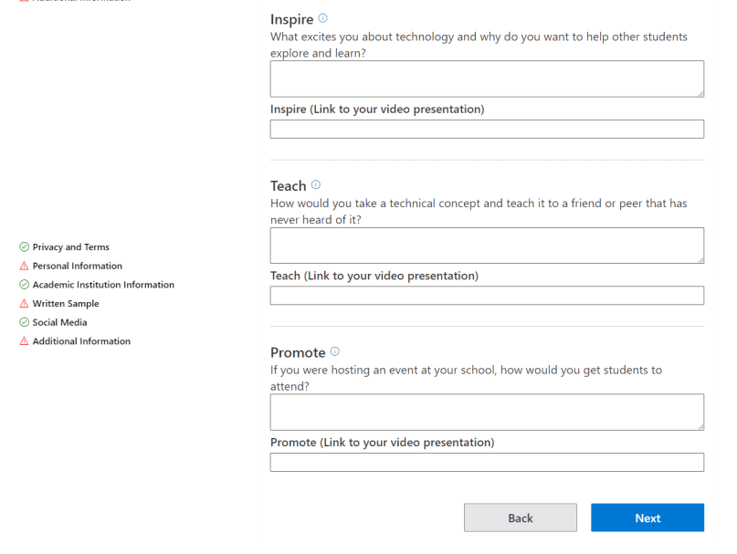

Slide 5
MILESTONES
Once you are selected for the program, you can achieve the following milestones. Each milestone has it own benefits.
Alpha
Beta
Gold

Slide 6
LEAGUES
Leagues are designed to allow you to engage in topics you are passionate about while enabling you to develop skills, share knowledge with your communities and get professional mentorship.
Technical Leagues:
AI and Machine Learning
Data Analytics
Internet of Things
Mobile and Web Development

Slide 7
Social Impact Leagues:
Digital Accessibility
Education
Green Tech
Healthcare

Slide 8
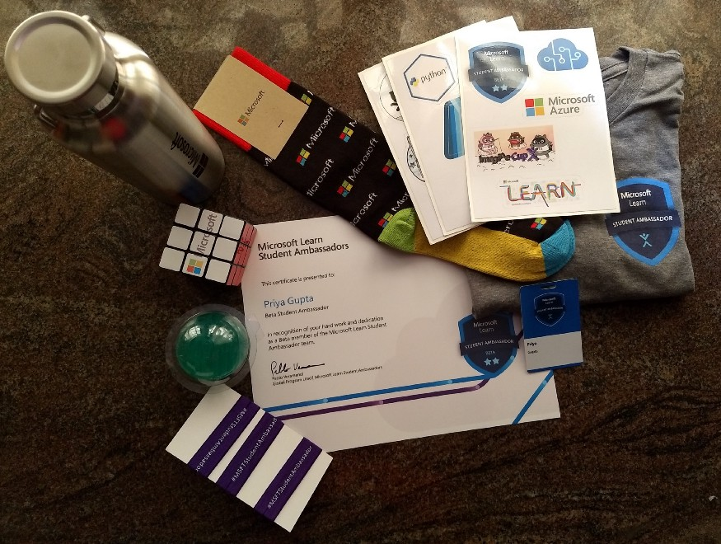
PERKS OF MLSA
Microsoft swags and goodies
USD150 monthly Azure credits
Office 365, Visual Studio Enterprise, Techsmith Snagit and Camtasia softwares for free.
MTC certification exam vouchers and LinkedIn learning free for 6 months.
Mentorship and networking with Microsoft professionals. and much more !

Slide 9

Introduction to Web Development
Web development is the work involved in developing a Website for the Internet. Web development can range from developing a simple single static page of plain text to complex web applications, electronic businesses, and social network services.

Slide 10







Slide 11
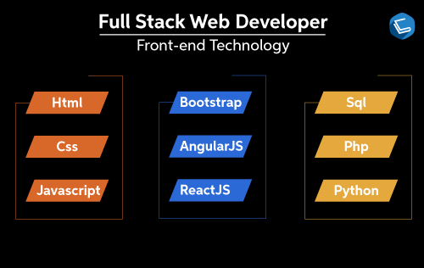
Web Development can be classified into two ways:
Frontend Development- This list includes HTML, CSS and JavaScript.
Backend Development-The list of back end frameworks are: Express, Django, Rails, Laravel, Spring, etc.

Slide 12
HTML
HTML stands for Hyper Text Markup Language. It is the standard markup language for creating Web pages. It describes the structure of a Web page.
HTML consists of a series of elements. Its elements tell the browser how to display the content.
HTML elements label pieces of content such as "this is a heading", "this is a paragraph", "this is a link", etc.

Slide 13
CSS
CSS stands for Cascading Style Sheets.
CSS describes how HTML elements are to be displayed on screen. CSS saves a lot of work. It can control the layout of multiple web pages all at once.
External stylesheets are stored in CSS files.

Slide 14
JavaScript
JavaScript to program the behavior of web pages.
You don't have to get or download JavaScript.
JavaScript is already running in your browser on your computer, on your tablet, and on your smart-phone.
JavaScript is free to use for everyone.

Slide 15
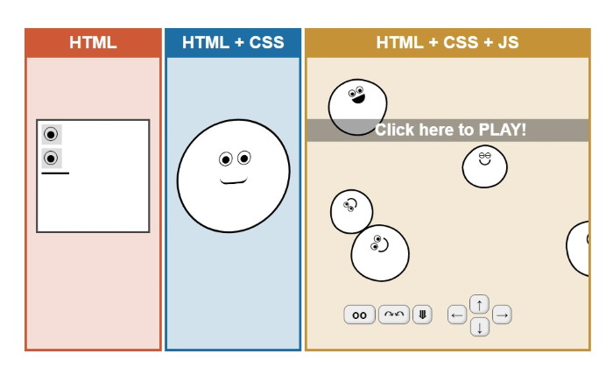

Slide 16

Introduction to Visual Studio Code

Slide 17
Visual Studio Code is an open source, lightweight, and full-featured text editor that supports a multitude of extensions for all kinds of developers. If you are getting started in the larger world of web development, Visual Studio Code can be a valuable tool. Features such as build scripts, environments, debugging, and more, combined with its role of powerful text editor, are of particular value to new developers. Visual Studio Code handles all this in one environment without the traditionally heavy integrated development environment (IDE).

Slide 18
Install Visual Studio Code
Browse to https://code.visualstudio.com and select the stable build for your platform.
During installation, be sure to check out the options presented and select any opt-in features you'd like. These options are mostly for convenience and personal preference, so you can accept the defaults to simplify your installation.

Slide 19
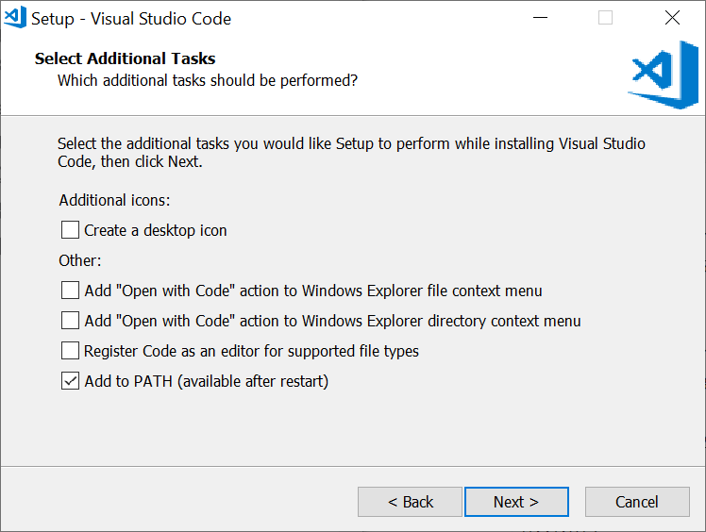

Slide 20

Let’s take a quick tour

Slide 21
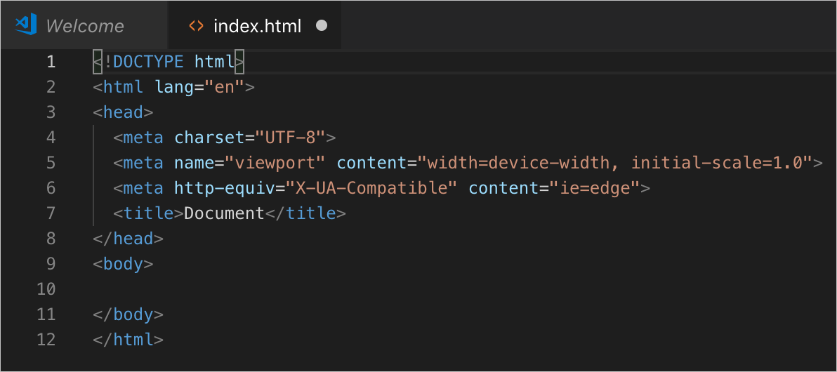
Build and preview a basic web app
First test: Hello World

Slide 22
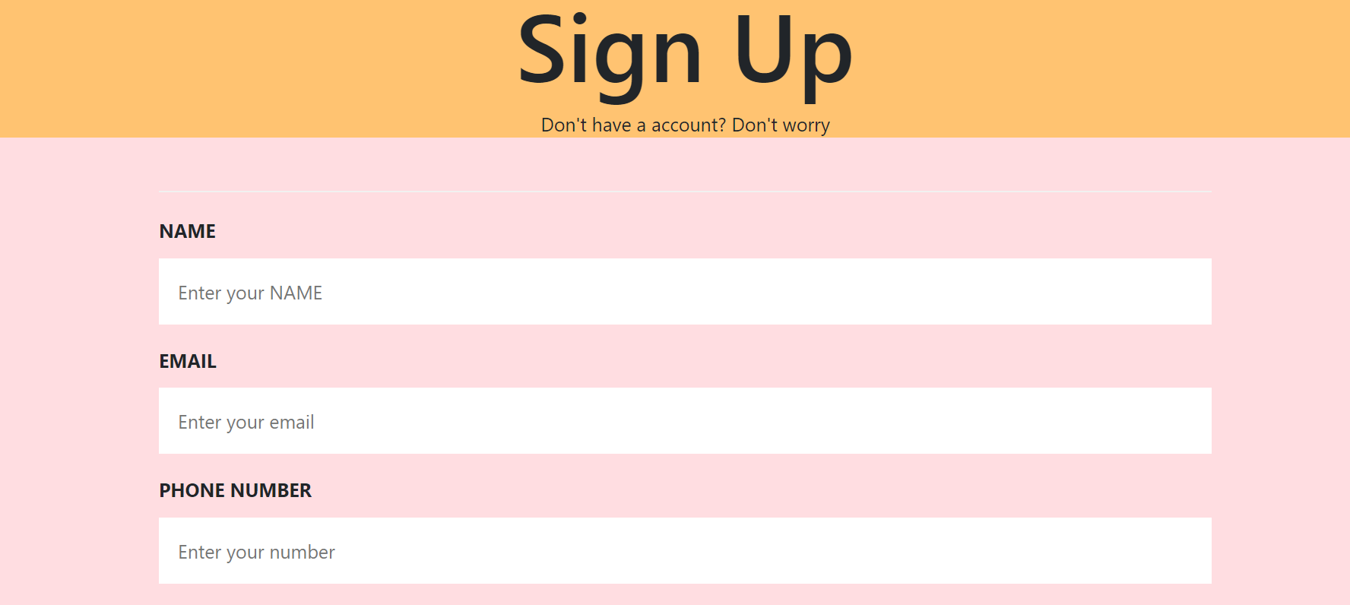
Sign Up Form

Slide 23

Any Questions?

Slide 24
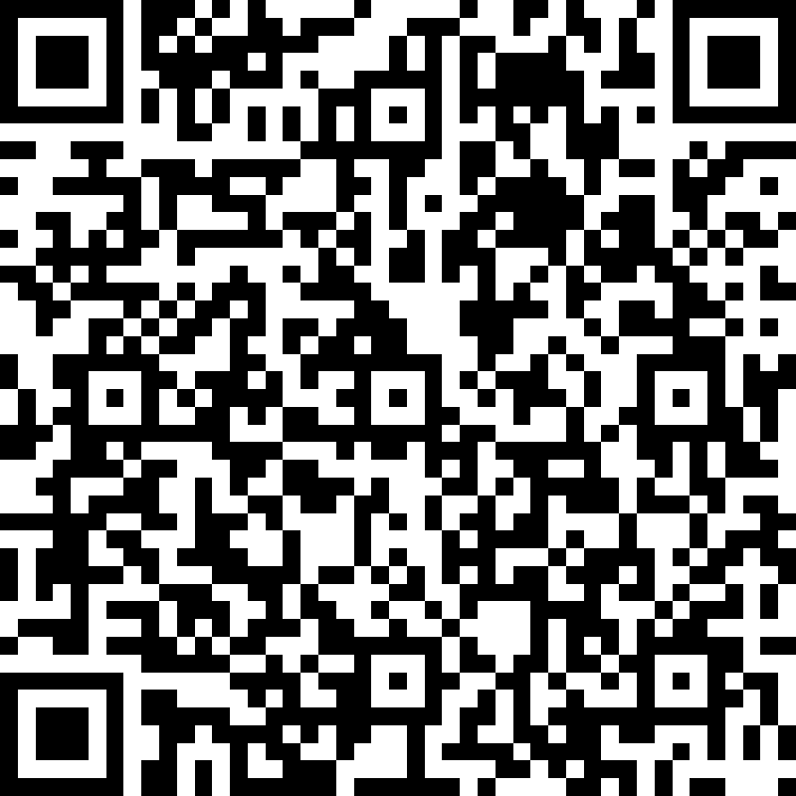
Thank You for attending the session!
QR code for feedback form
FEEDBACK FORM: https://forms.office.com/r/hmTJE3ZDwd

